Slide 1
RoomHive
A Student accommodation portal

Slide 2
Team members
Name | Registration Number
Vemuri Somesh | 3122 21 5002 121
Vigneshwaran R | 3122 21 5002 122
Vijay V | 3122 21 5002 123
Vijaymurugan N | 3122 21 5002 124
Vishal Prakash | 3122 21 5002 125
Vishnu Siddharth V R | 3122 21 5002 126

Slide 3
Problem Statement
To create a web-based application that assists students in finding the optimal accommodation options in a city based on their preferences for amenities, budget, and proximity to desired locations.

Slide 4

Client Details
Dr. S. Sasirekha B.E., M.E., Ph.D.
Associate Professor
Email: sasirekhas@ssn.edu.in
Extn: 372
Dr. S. Sasirekha is an Associate Professor at SSN College of Engineering with expertise in Service Oriented Architecture and Semantic based IoT middleware. She has 13+ years of teaching experience, a Ph.D. from Anna University, and has published over 35 papers. Dr. Sasirekha is an active member of IEEE and ACM, serves as a reviewer for esteemed publishers, and is involved in various national and international conferences. She guides Ph.D./M.S. candidates and has supervised numerous projects. Additionally, she serves as one of the Non-Residential Wardens of SSNCE.

Slide 5
Client Requirements
Once a student enters a college location, he/she should be shown nearby accommodation that satisfies their conditions.
The student must be able to give filters such as Price, Occupancy, etc.
The hostels displayed must be reliable and the information present in the website must be update and valid.
The hostels must be located in a place with high population density so that it is safe for the students and other shops are also accessible for the students.

Slide 6
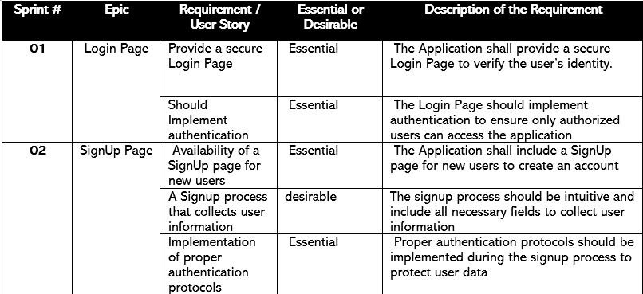
Requirements Specifications

Slide 7
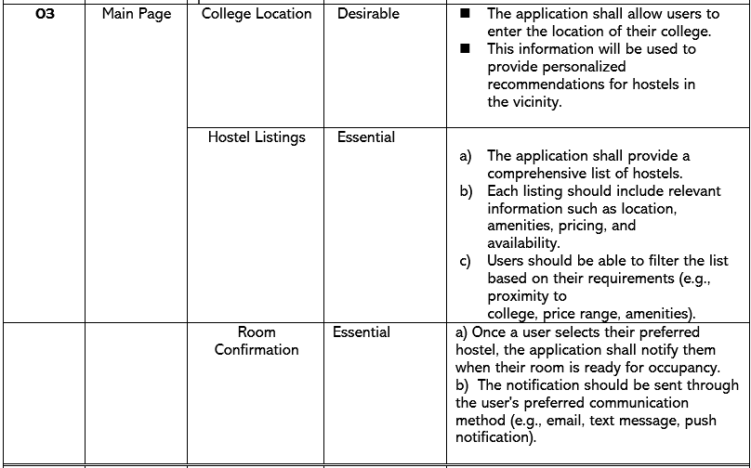
Requirements Specifications

Slide 8
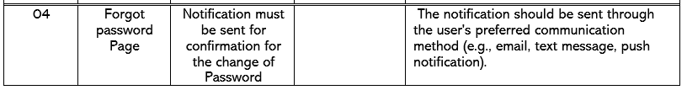
Requirements Specifications

Slide 9
Solution Design
Using JavaScript, HTML/CSS, and Python, the application will employ suitable algorithm to categorize available accommodations.
The algorithm will consider factors such as the presence of amenities, rental prices, and distances from educational institutions and popular student areas.
By providing a user-friendly interface, students will be able to input their preferences and receive personalized recommendations.
To implement DBMS connectivity, we create a login system to facilitate authentication.
An OTP system can also be implemented.

Slide 10
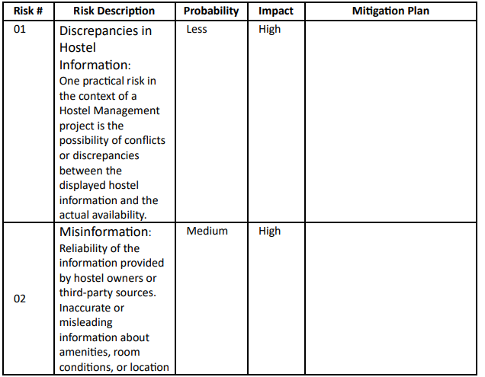
Risk Management

Slide 11
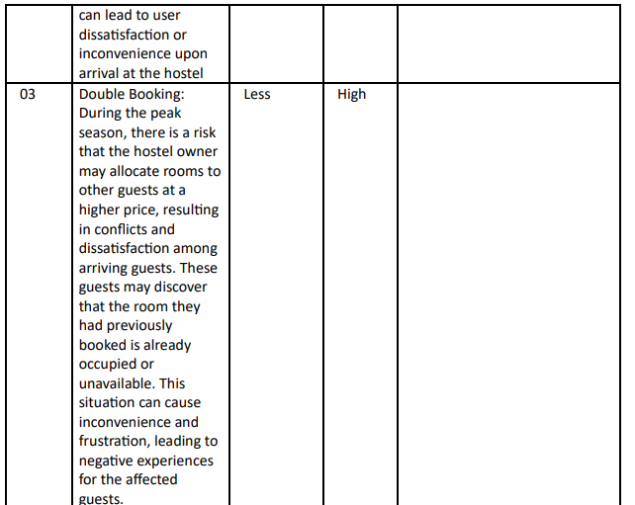
Risk Management

Slide 12
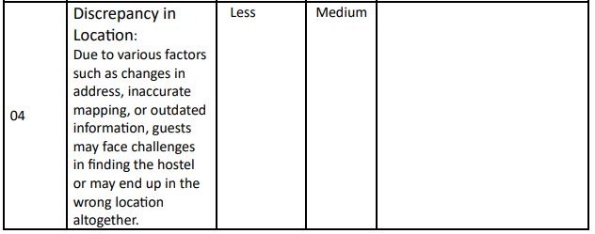
Risk Management

Slide 13
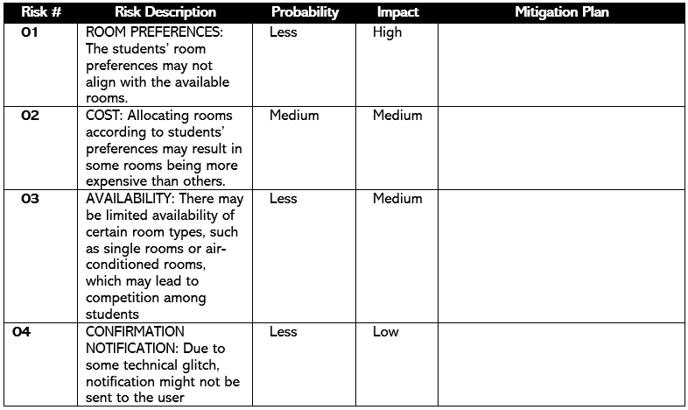
Risk Management

Slide 14
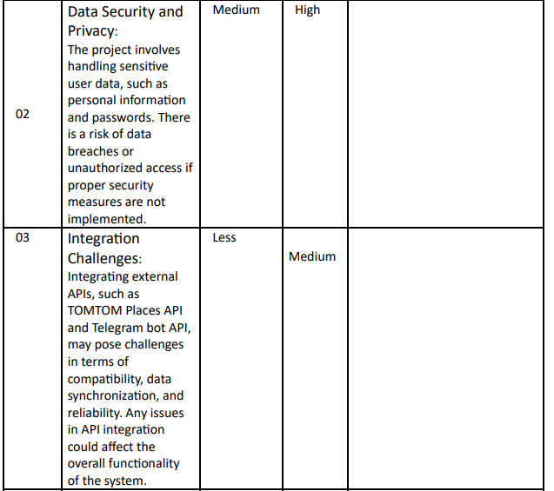
Risk Management

Slide 15
Roles and Responsibilities
Role | Name
Scrum Master | Vigneshwaran R
Product Owner | Vishal Prakash
Tester | Vijaymurugan N
Product Designer | Vishnu Siddharth V R
Front-End Developer | Vishal Prakash Vishnu Siddharth V R
Back-End Developer | Vijay V Vemuri Somesh Vigneshwaran R

Slide 16
Algorithm Used
1.Greedy algorithm – Similar to knapsack problem
The conditions (filters) given by the customers multiplied by 3 will be taken as the capacity and the weight of the individual hotels are calculated by the sum of their properties. The value will be taken as the number of hotels.
The capacity is multiplied by 3 , to produce 3 best fit hostels as the most suitable.
2. Greedy algorithm
The hostels that do not satisfy the conditions given by the students are displayed in the ascending order of their budget and by the number of conditions satisfied such that the hostels that satisfy the maximum number of conditions are displayed first.

Slide 17
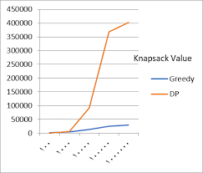
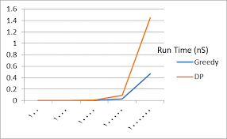
Knapsack – DP vs Greedy
When the capacity of the sack is limited, the maximum number of items that can be put in the sack is also limited, the greedy algorithm is a better choice compared to the dynamic programming approach.

Slide 18
Algorithm Analysis
Time Complexity of Algortithm used (Knapsack): O(n)
Time Complexity of API call and Telegram Bot : It totally depends on the efficiency of the API server and the network latency, so it may not have a well-defined notation like O(n) as it depends on various underlying processes.
Time Complexity of displaying maps: O(

Slide 19
Implementation

Slide 20

Login Page

Slide 21
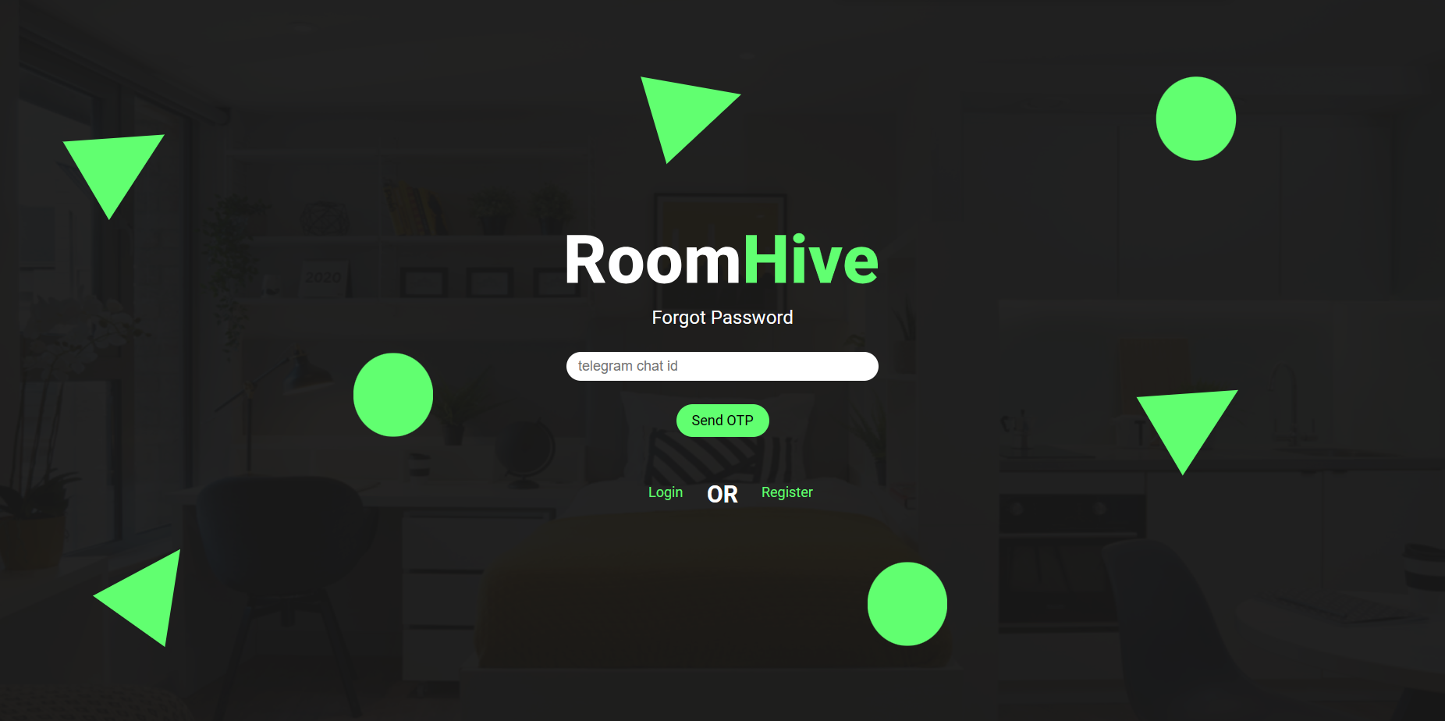
Forgot Password Page

Slide 22
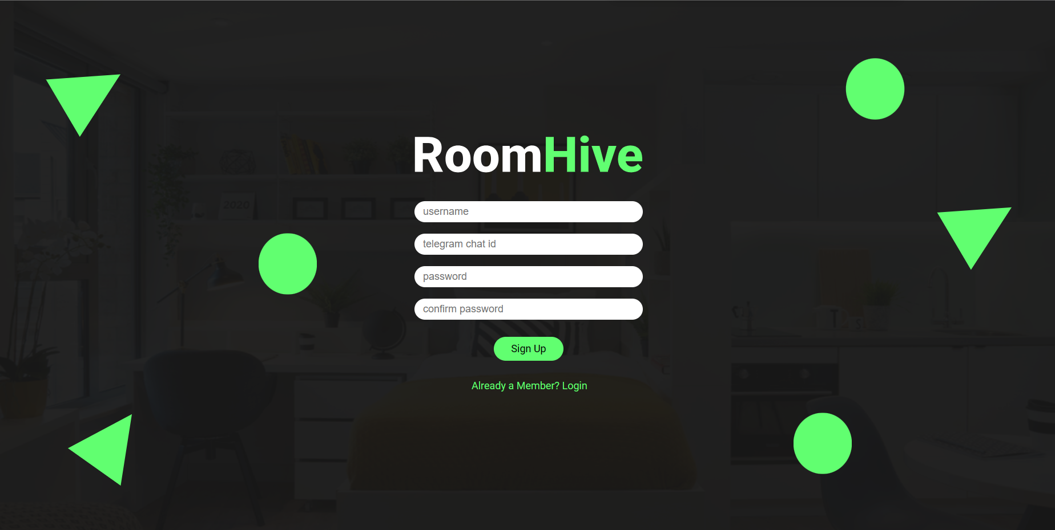
Register Page

Slide 23

OTP Verification Page

Slide 24
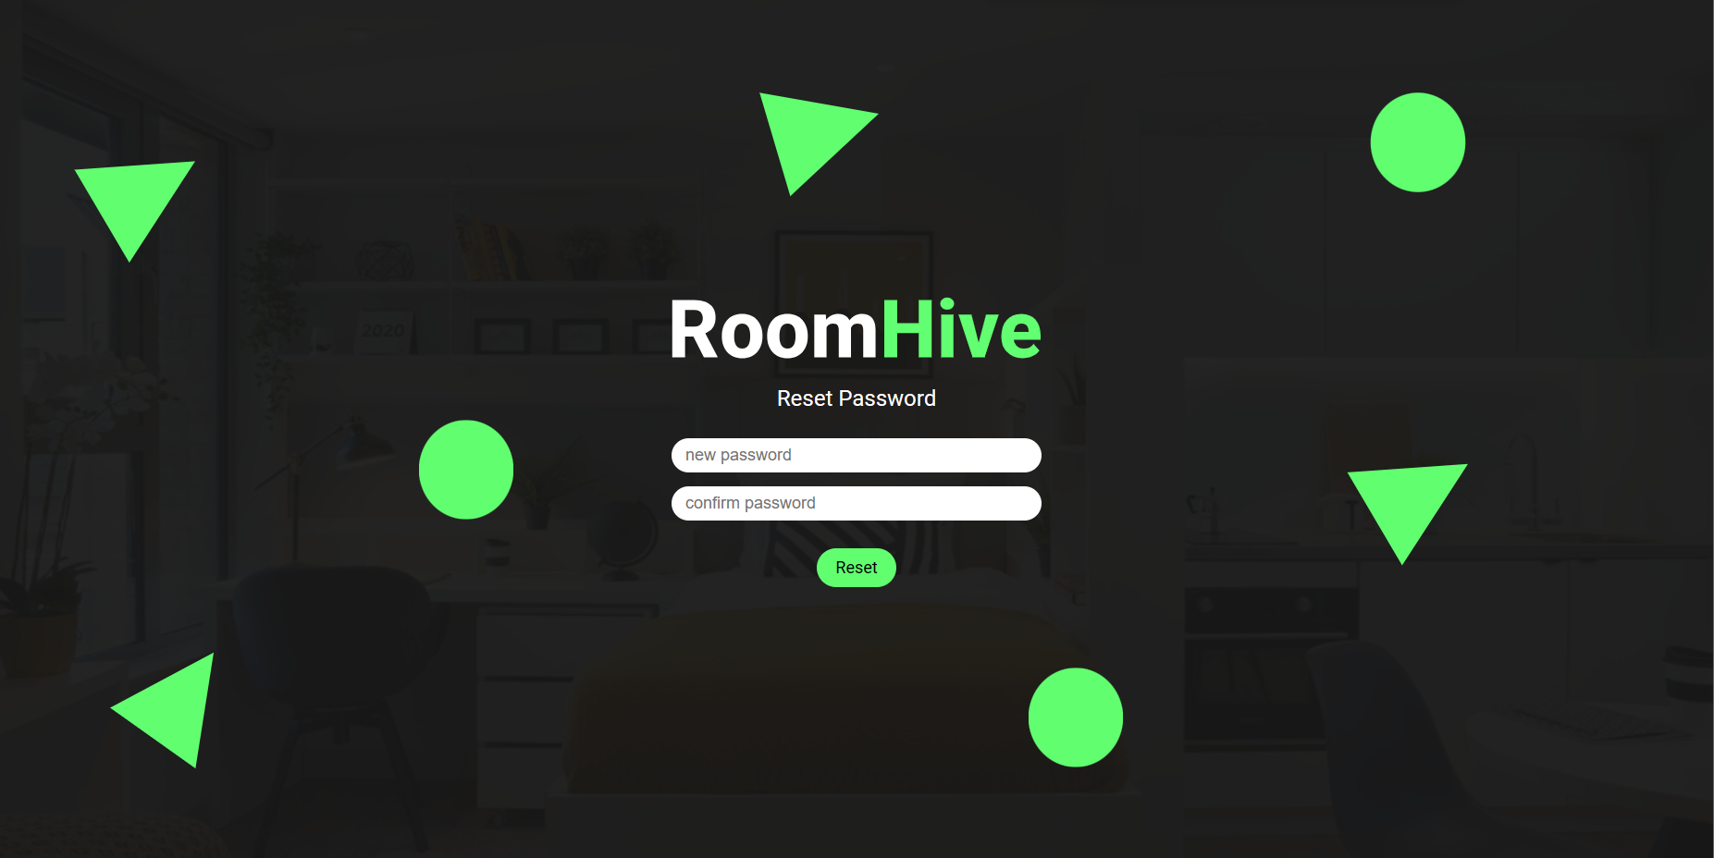
Reset Password Page

Slide 25
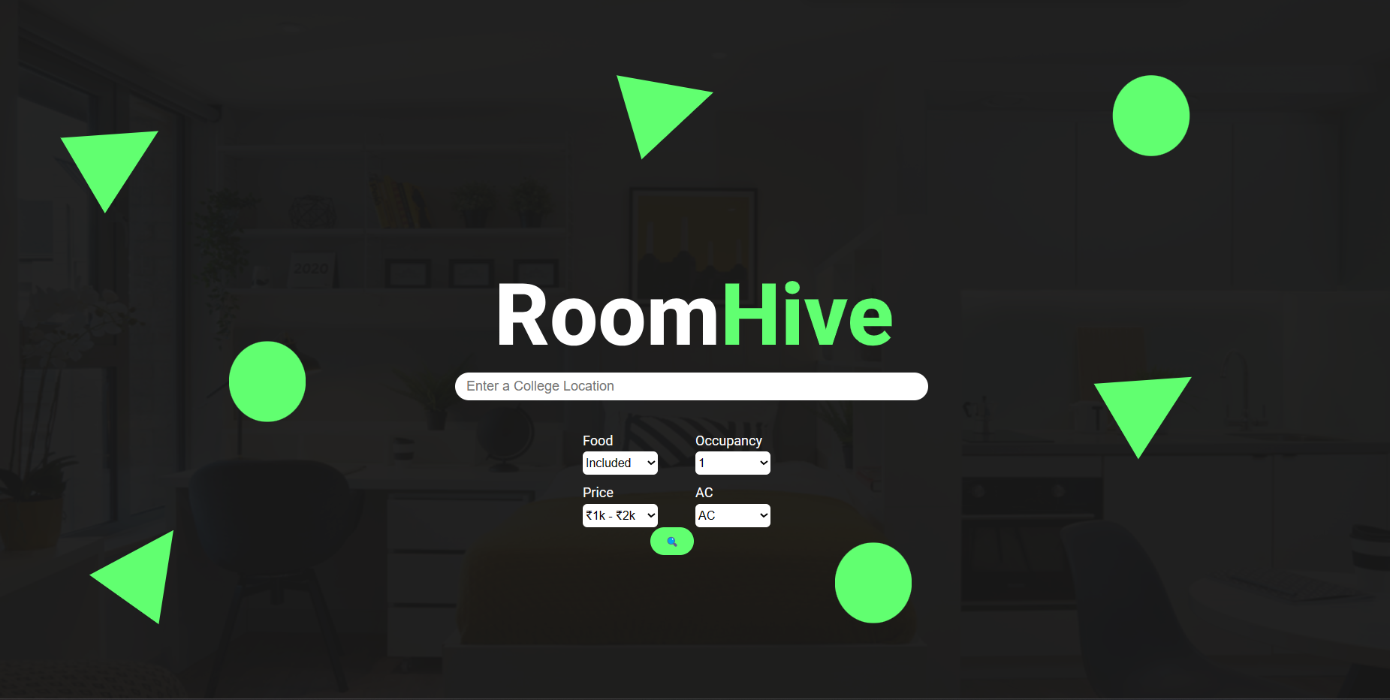
Search Home Page

Slide 26
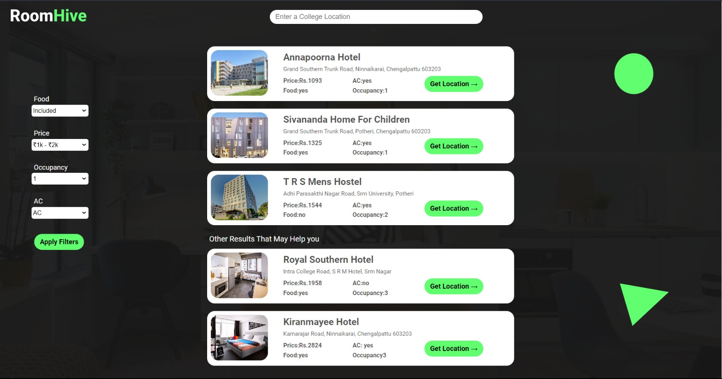
Search Result Page

Slide 27
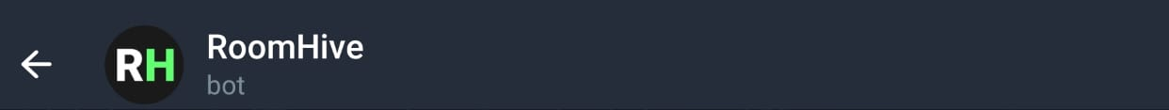
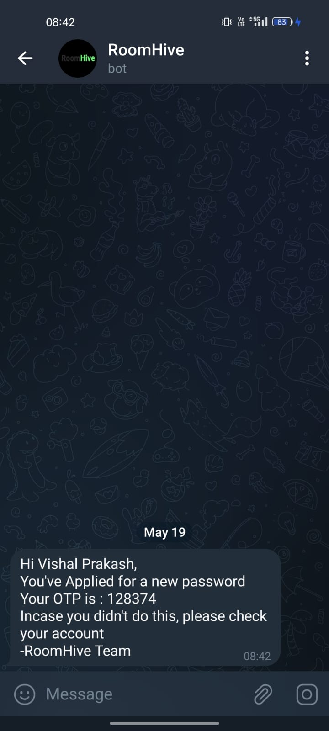
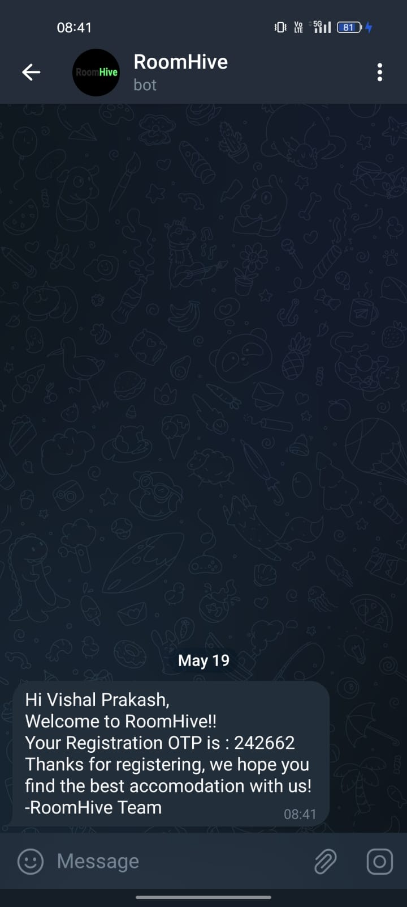
RoomHive Telegram Bot

Slide 28
Front End - Summary
Number of files : 13
Languages used: HTML, CSS, JavaScript
Total Lines Of Code (LOC): 2304
Number of Jira Sprints: 4
Front end design ideation tool: Figma

Slide 29
Back End - Summary
Number of files : 6
Languages used: Python, SQL
Libraries used: flask, pandas, openpyxml, telegram, mysql
Total Lines Of Code (LOC): 1074
Number of Jira Sprints: 4

Slide 30
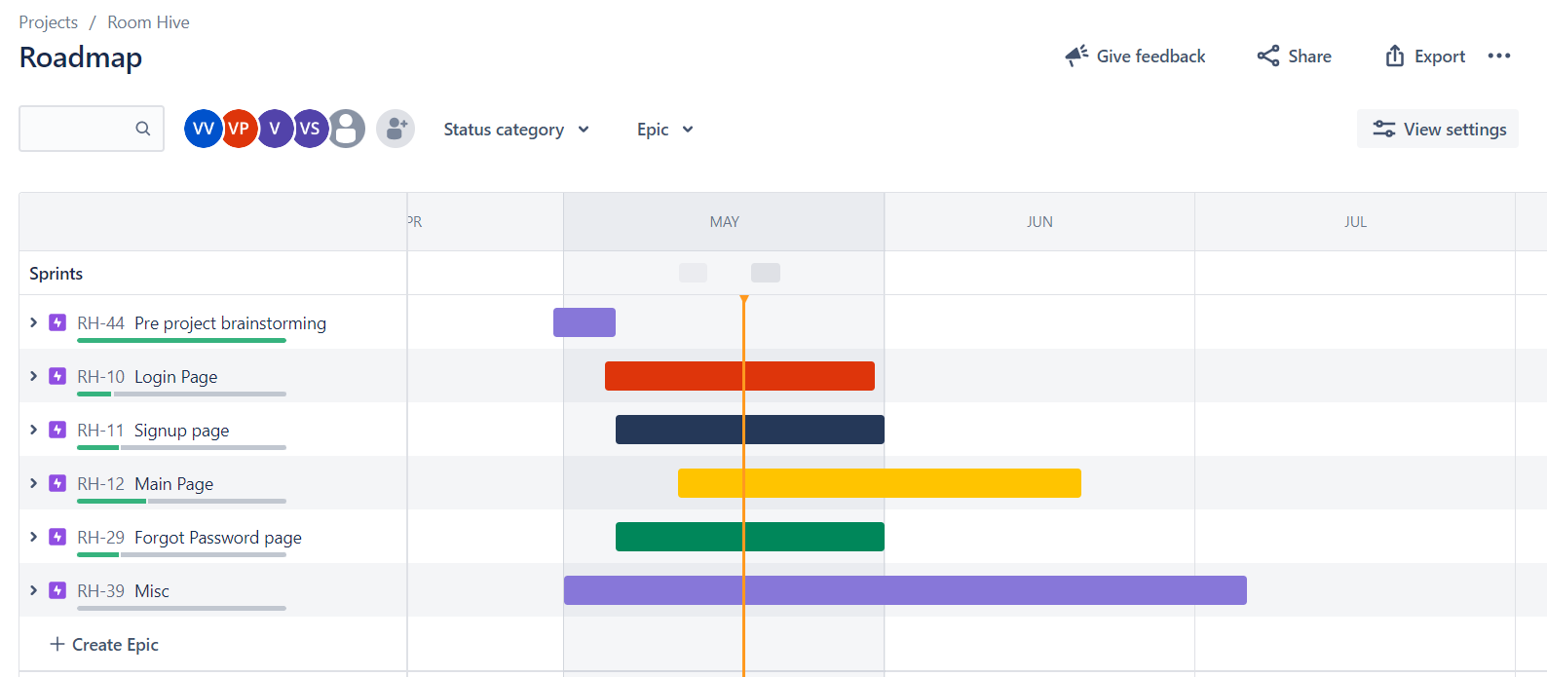
Using Jira Tool
Project Roadmap

Slide 31
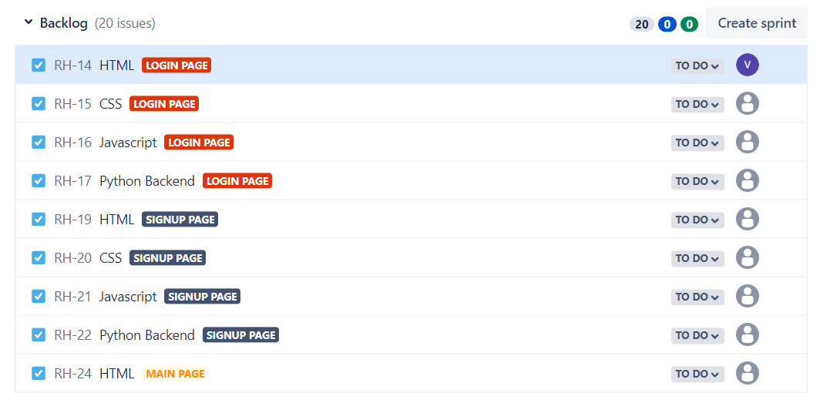
Using Jira Tool
Project Backlog

Slide 32
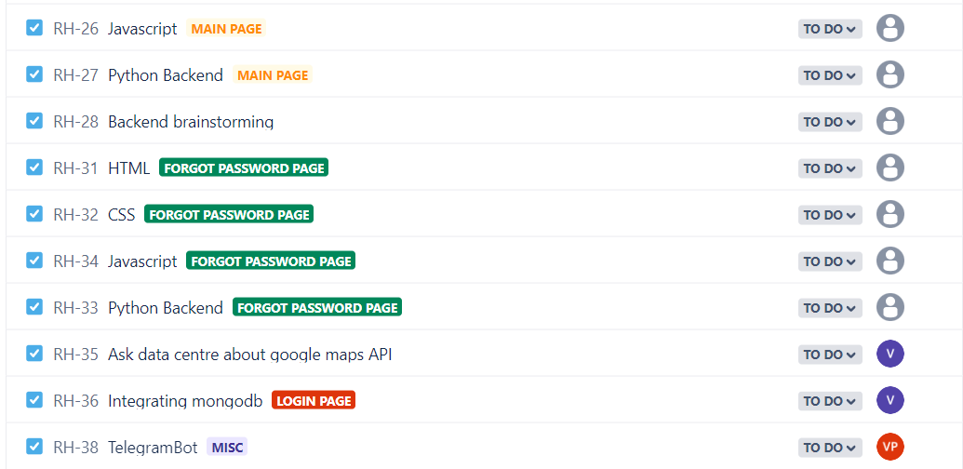
Using Jira Tool
Project Backlog

Slide 33
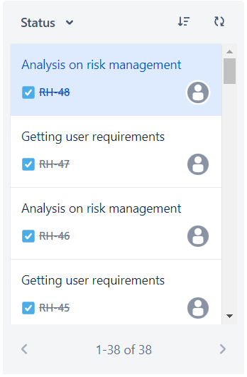
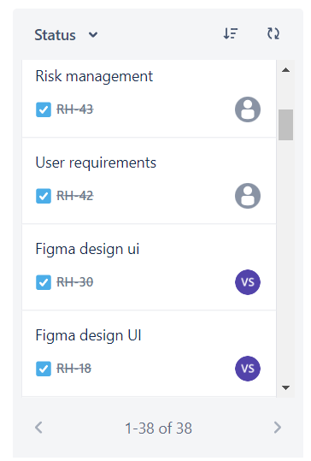
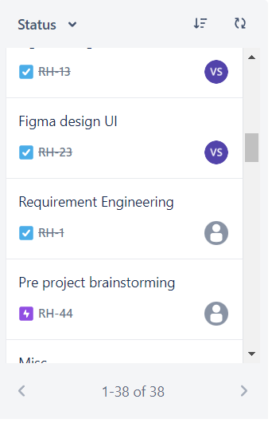
Using Jira Tool
Completed issues till date

Slide 34
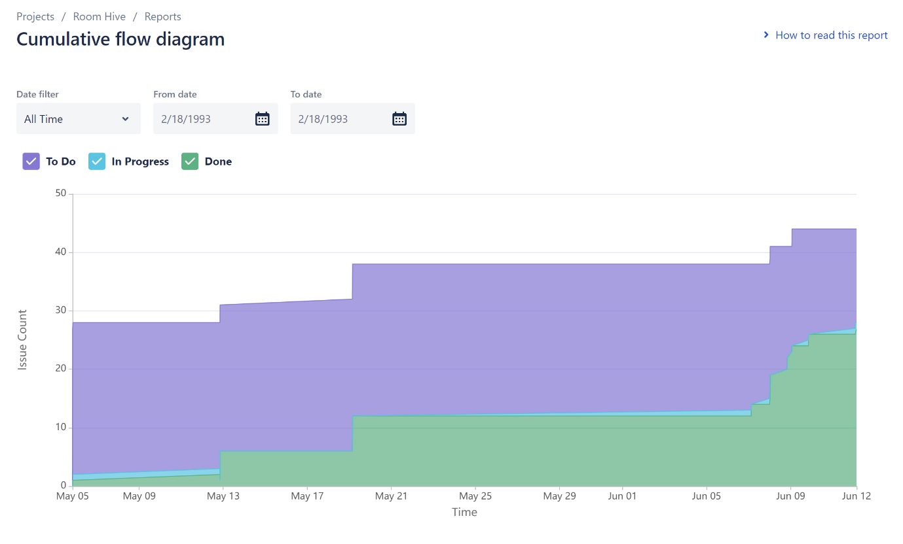
Using Jira Tool

Slide 35
For More Information
Jira Software Project Link : https://id.atlassian.com/invite/p/jira-software?id=lqOpY_i0TM6GdznlcQve5A
Confluence (Project Documents) : https://id.atlassian.com/invite/p/confluence?id=VtIhWBKLTf2H3125H0IfeA

Slide 36
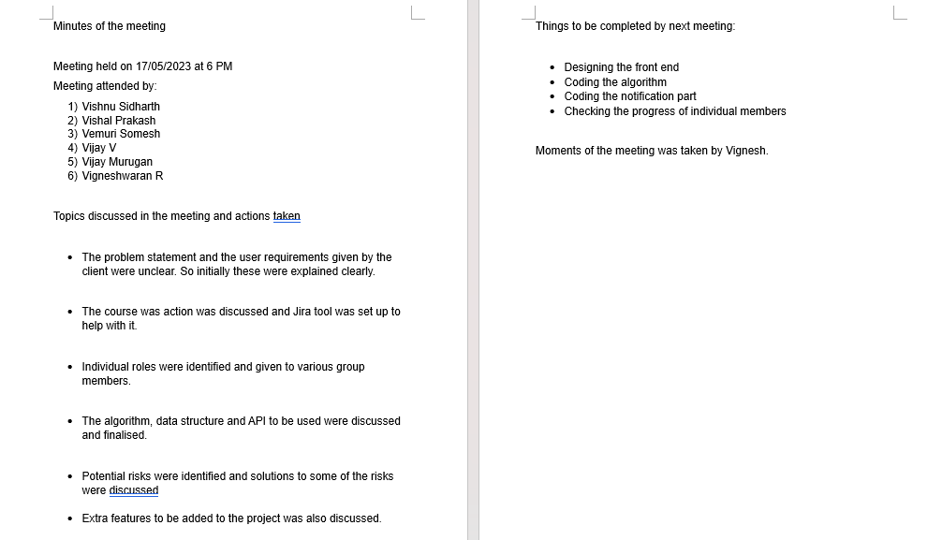

Slide 37
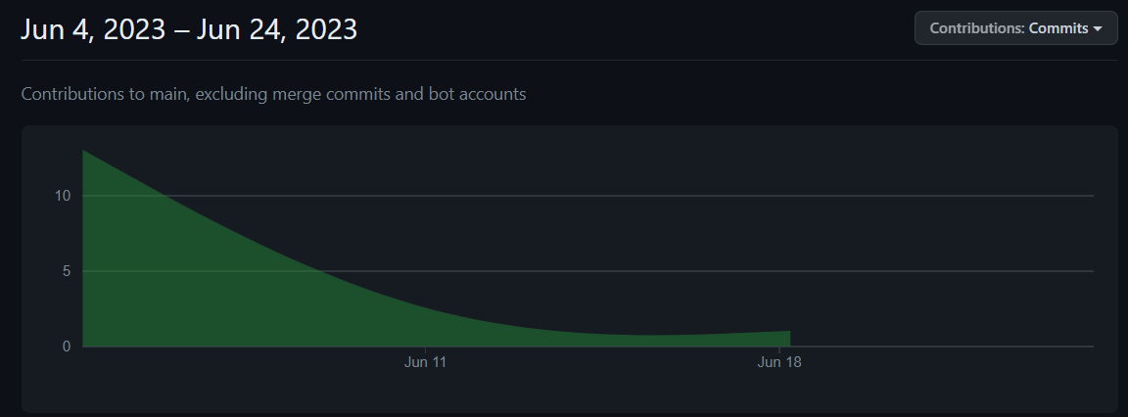
Github Repo
https://github.com/HallowSiddharth/RoomHive

Slide 38
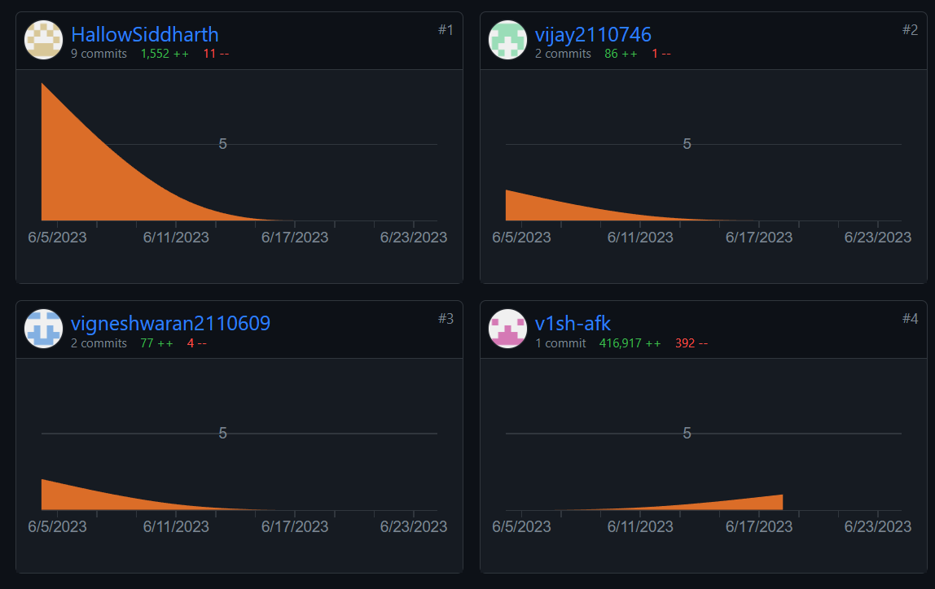
Github Repo

Slide 39











Languages Used
Platforms Used

Slide 40
Future Scope For This Project
Results can be sent via telegram.
This application can be deployed into a server.
TomTom API can be replaced by google maps API for more efficiency.
We can use twilio to send OTP via WhatsApp instead of Telegram.

Slide 41
Thankyou

